Slide 1


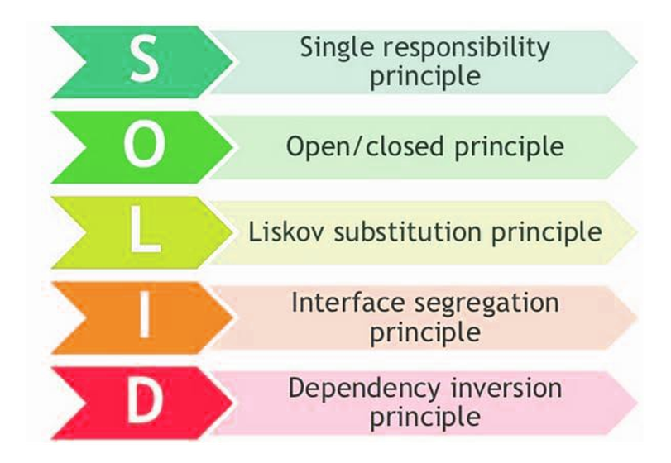

SOLID Principles
Design Principles and Approaches
OOP Advanced
C#
SoftUni Team
Technical Trainers
Software University
http://softuni.bg

Slide 2

Table of Contents
Single Responsibility Principle
Open/Closed Principle
Liskov Substitution Principle
Interface Segregation Principle
Dependency Inversion

Slide 3
Questions
sli.do #CSharp-Fund

Slide 4
Why Clean Code Matters?
How clean code (or its absence) affects our software?
“...So if you want to go fast,
if you want to get done quickly,
if you want your code to be easy to write,
make it easy to read.”
– Robert C. Martin

Slide 5
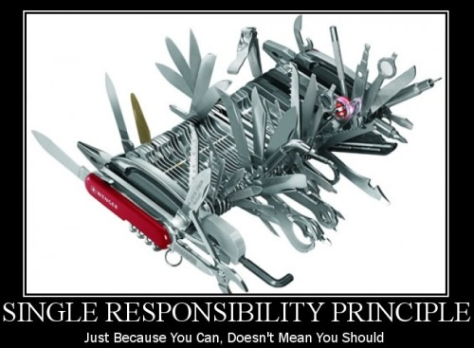
Single Responsibility

Slide 6

What is Single Responsibility?
Every class should be responsible for only a single part of the functionality, and that responsibility should be entirely encapsulated by the class.
“There should never be more than one reason for a class to change.”
- Robert C. “Uncle Bob” Martin

Slide 7
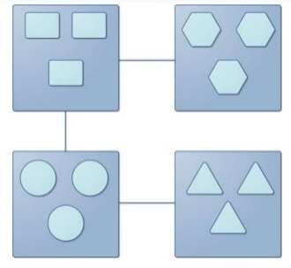
Strong Cohesion / Loose Coupling
Cohesion refers to the grouping of functionally related processes into a particular module.
Aim for strong cohesion
Each task maps to a single code unit
A method should do one operation
A class should represent one entity
Notes:
Cohesion
Low: The convenience store. You go there for everything from gas to milk to ATM banking. Products and services have little in common, and the convenience of having them all in one place may not be enough to offset the resulting increase in cost and decrease in quality.
High: The cheese store. They sell cheese. Nothing else. Can't beat 'em when it comes to cheese though.
More inner instance variables – harder cohesion
Coupling
Loose: You and the guy at the convenience store. You communicate through a well-defined protocol to achieve your respective goals - you pay money, he lets you walk out with the bag of Cheetos. Either one of you can be replaced without disrupting the system.
Tight: You and your wife.

Slide 8
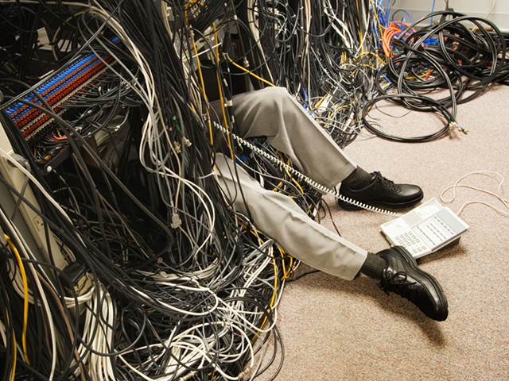
Strong Cohesion / Loose Coupling (2)
Coupling – the degree of dependence between modules that comes in two senses
How closely connected two modules are
The strength of relationship between modules
Aim for loose coupling
Supports readability and maintainability
Often a sing of good design
Notes:
Cohesion
Low: The convenience store. You go there for everything from gas to milk to ATM banking. Products and services have little in common, and the convenience of having them all in one place may not be enough to offset the resulting increase in cost and decrease in quality.
High: The cheese store. They sell cheese. Nothing else. Can't beat 'em when it comes to cheese though.
More inner instance variables – harder cohesion
Coupling
Loose: You and the guy at the convenience store. You communicate through a well-defined protocol to achieve your respective goals - you pay money, he lets you walk out with the bag of Cheetos. Either one of you can be replaced without disrupting the system.
Tight: You and your wife.

Slide 9
Cohesion and Coupling - Approaches
Small number of instance variables inside a class
Each method of a class should manipulate one or more of those variables.
Two modules should exchange as little information as possible
Is the subsystem easily reusable in another project?

Slide 10
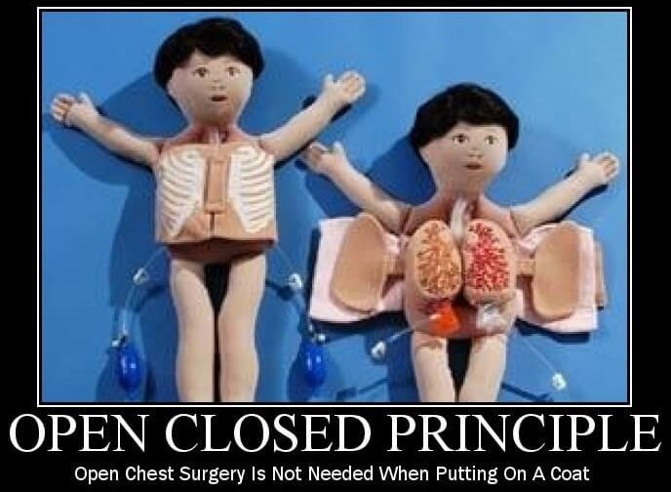
Open/Closed

Slide 11
What is the Open/Closed Principle?
Software entities like classes, modules and functions should be open for extension, but closed for modifications
Extensibility – adding new behavior doesn’t require changes over existing source code
Reusability – subsystems are suitable for reusing in other projects – modularity

Slide 12

Design Smell - Violations
Need to retest after changes
Old parts changed -> possible bugs
Cascading changes through modules
Logic depends on conditional statements (“IS-A” checking)

Slide 13
OCP - Approaches
Parameters - control behavior specifics via a parameter, delegate
Rely on abstraction, not implementation
Inheritance / Template Method Pattern
Strategy Pattern
Plug in model (insert new implementation of the interface)
Notes:
When we use abstraction there is no limit in implementation

Slide 14
OCP - When to Apply
By experience – know the problem domain and if a change / modification is very likely to recur
New domain problem – implement the most simple way
Changes once – modify, second time – refactor
TANSTAAFL – There Ain’t No Such Thing As A Free Lunch
OCP adds complexity to design
No design can be closed against all changes - know which ones to guard
Notes:
It's best not to try to predict the future, but once a change is needed, modify the design so future changes of that same kind can be accommodated.

Slide 15
Template Method Pattern
AbstractClass
+ templateMethod()
+ stepOne()
+ stepTwo()
. . .
Varying behavior
ConcreteClassOne
+ stepOne()
+ stepTwo()
ConcreteClassTwo
+ stepOne()
+ stepTwo()
Implementation

Slide 16
Template Method Pattern (2)
public abstract class CrossCompiler
{
public void CrossCompile()
{
this.CollectSource();
this.CompileToTarget();
}
protected abstract void CollectSource();
protected abstract void CompileToTarget();
}
Template method

Slide 17
Template Method Pattern (3)
public class IPhoneCompiler : CrossCompiler
{
protected override void CollectSource() { //sth spec}
protected override void CompileToTarget()
{ //iphone specific compilation }
}
public class AndroidCompiler : CrossCompiler
{
protected override void CollectSource() {//sth spec}
protected override void CompileToTarget()
{ //android specific compilation }
}

Slide 18
Problem: Stream Progress Info
Refactor skeleton given for this problem:
StreamProgressInfo class must work with Music class too
Be sure if you add new class which provide BytesSent and Length getters will work without touching StreamProgressInfo

Slide 19
Solution: Stream Progress Info
public class StreamProgressInfo
{
private IStreamable streamable;
public StreamProgressInfo(IStreamable streamResult)
{
this.streamable = streamResult;
}
public int CalculateStreamProgress()
{
return (this.streamable.BytesSent * 100) /
this.streamable.Length;
}
}
Notes:
There are two ways to achieve abstraction
- Using Abstract Classes
- Using Interfaces

Slide 20
Solution: Stream Progress Info (2)
public interface IStreamable
{
int Length { get; }
int BytesSent { get; }
}
public class File : IStreamable
{
//TODO: Add business logic
}
public class Music : IStreamable
{
//TODO: Add business logic
}
Notes:
There are two ways to achieve abstraction
- Using Abstract Classes
- Using Interfaces

Slide 21
Problem: Graphic Editor
Refactor skeleton given for this task so that:
GraphicEditor class draws all kinds of shapes without asking what kind of shape we pass
Be sure if you add a new type of shape, the system will still work correctly without touching GraphicEditor

Slide 22
Solution: Graphic Editor
public class GraphicEditor
{
void DrawShape(Shape shape)
{ shape.Draw(); }
}
public interface IShape {
void Draw();
}
public class Rectangle : IShape
{
public void Draw()
{
Console.WriteLine("I'm Rectangle");
}
}
//TODO: Make the same for Circle
Notes:
There are two ways to achieve abstraction
- Using Abstract Classes
- Using Interfaces

Slide 23
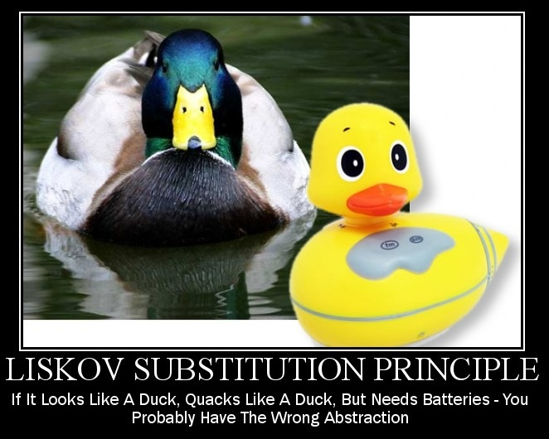
Liskov Substitution Principle

Slide 24
What is Liskov Substitution?
“Derived types must be completely substitutable for their base types”
– Barbara Liskov, 1988

Slide 25
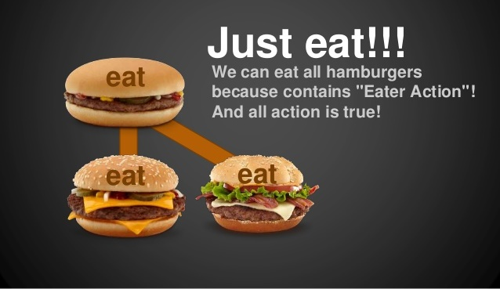
LSP - Substitutability
References to the base class can be replaced with a derived class without affecting the functionality of the program
Derived class only extends functionalities of the base class
Derived class must not remove base class behavior

Slide 26
LSP Relationship
OOP Inheritance
Plus LSP
Student IS-A Person
Student IS-SUBSTITUTED-FOR Person
Notes:
E.g. Animal is substitutable for Dog

Slide 27
Design Smell - Violations
Type Checking
Overridden methods say "I am not implemented"
Base class depends on its subtypes

Slide 28
OCP – Approaches
Tell Don’t Ask – if you need to check what is the object - move the behavior inside the object
New Base Class - two classes share common behavior but are not substitutable, create third from which both derive
There shouldn’t be any virtual methods in constructors
Notes:
Usually from base ctor to child
Virtual methods from child to base
Base class – depends on the child

Slide 29

Interface Segregation

Slide 30
What is Interface Segregation?
"Clients should not be forced to depend on methods they do not use."
- Agile Principles, Patterns, and Practices in C#
Segregate interfaces
Prefer small, cohesive (lean and focused) interfaces
Divide "fat" interfaces into "role" interfaces
Notes:
Получава се в два случая – малко от вас ще тръгнат да пишат огромни интерфейси, но дори и при два метода може да се получи грешка

Slide 31
Fat Interfaces
Classes whose interfaces are not cohesive have "fat" interfaces
public interface IWorker
{
void Work();
void Sleep();
}
Class Employee is OK
public class Robot : IWorker
{
void Work() {}
void Sleep()
{ throw new NotImplementedException() }
}

Slide 32
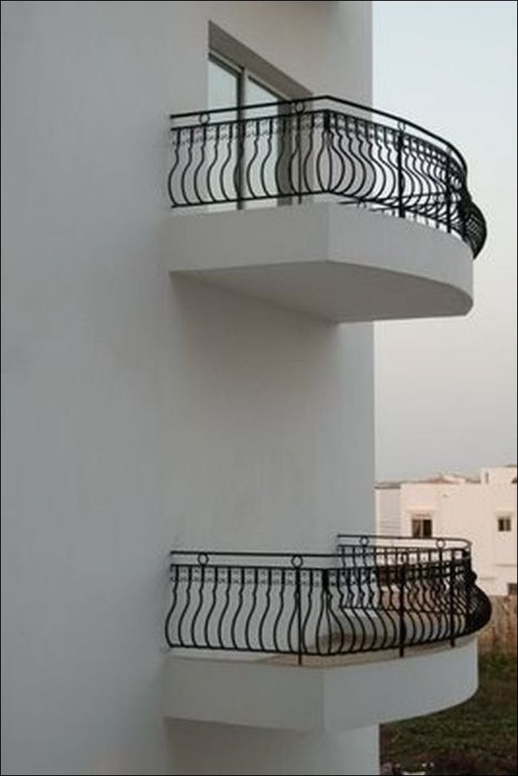
Design Smells - Violations
Not implemented methods
Client references a class but only use small portion of it
“Abstraction is elimination
of the irrelevant and
amplification of the essential.”
– Robert C. Martin

Slide 33
ISP - Approaches
What does the client see and use?
The “fat” interfaces implement a number of small interfaces with just what you need
All public members of a class divided in separate classes – again could be thought of as an interface
Let the client define interfaces – "role" interfaces

Slide 34
Cohesive Interfaces
Small and Cohesive "Role" Interfaces
public interface IWorker
{
void Work();
}
public interface ISleeper {
void Sleep();
}
public class Robot : IWorker
{
void Work() { // Do some work… }
}

Slide 35
Adapter Pattern
Problem that the Adapter pattern solves
Reusing classes that does not have an interface that a client requires
Making classes with incompatible interfaces work together
Provide an alternative interface for a class

Slide 36
Adapter Pattern
Convert the (incompatible) interface of a class (Adaptee) into another interface (Target) that clients require
class Adaptee
{
public void SpecificRequest()
{
Console.Write
("Called SpecificRequest()");
}
}
interface Target
{
void Request();
}

Slide 37
Adapter Pattern (2)
Define a separate class (Adapter) that does the job
class Adapter : Target
{
private Adaptee adaptee = new Adaptee();
public void Request()
{
// Possibly do some other work
// and then call SpecificRequest
adaptee.SpecificRequest();
}
}

Slide 38
Problem: Detail Printer
Refactor the skeleton given for this task so that
DetailsPrinter class prints correctly any kind of employee, which is in the collection
Remove any “is“ statements from your code
Be sure if you add new type of employee system that it will work correctly without touching DetailsPrinter

Slide 39
Solution: Detail Printer
public class Employee
{
private string name;
public Employee(string name)
{
this.name = name;
}
public override string ToString()
{
return $"Name: {this.name}";
}
}
Notes:
There are two ways to achieve abstraction
- Using Abstract Classes
- Using Interfaces

Slide 40
Solution: Detail Printer (2)
public class Manager : Employee
{
public Manager(string name,
ICollection<string> documents) : base(name)
{
this.Documents = new List<string>(documents);
}
public IReadOnlyCollection<string> Documents {get;set;}
public override string ToString()
{
return base.ToString() + $"Documents:
{string.Join(Environment.NewLine, this.Documents)}";
}
}
Notes:
There are two ways to achieve abstraction
- Using Abstract Classes
- Using Interfaces

Slide 41
Solution: Detail Printer (3)
public class DetailsPrinter
{
private IList<Employee> employees;
public DetailsPrinter(IList<Employee> employees)
{
this.employees = employees;
}
public void PrintEmployees()
{
foreach(Employee employee in employees)
Console.WriteLine(employee);
}
}
Notes:
There are two ways to achieve abstraction
- Using Abstract Classes
- Using Interfaces

Slide 42
Problem: Recharge
You are given some classes
Refactor the code so that it conforms to ISP
Consider the case that you don't own the library
New feature
Recharge Station
<IRechargeable>
(A) Worker
Current library
Employee
Robot

Slide 43
Solution: Rechargeable
Multiple Inheritance (If you own the library)
Recharge Station
<IRechargeable>
<ISleeper>
(A) Worker
Robot
Employee

Slide 44
Solution: Rechargeable (2)
Adapter Pattern (If you don't own the library)
Recharge Station
<IRechargeable>
(A) Worker
RobotAdapter
Robot
Employee

Slide 45
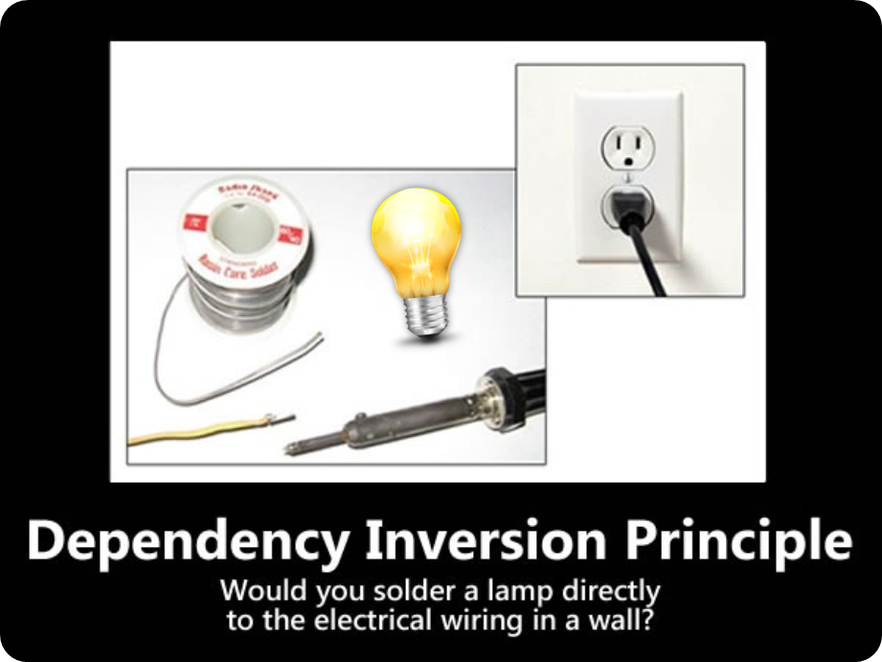
Dependency Inversion Principle

Slide 46
Goal of DIP
Decoupling modules
through abstractions (interfaces)
Notes:
"Dependency Inversion Principle says that high-level modules should not depend on low-level modules. Both should depend on abstractions."
"Abstractions should not depend on details. Details should depend on abstractions."
Agile Principles, Patterns, and Practices in C#
Goal: decoupling between modules through abstractions
Programming through interfaces

Slide 47
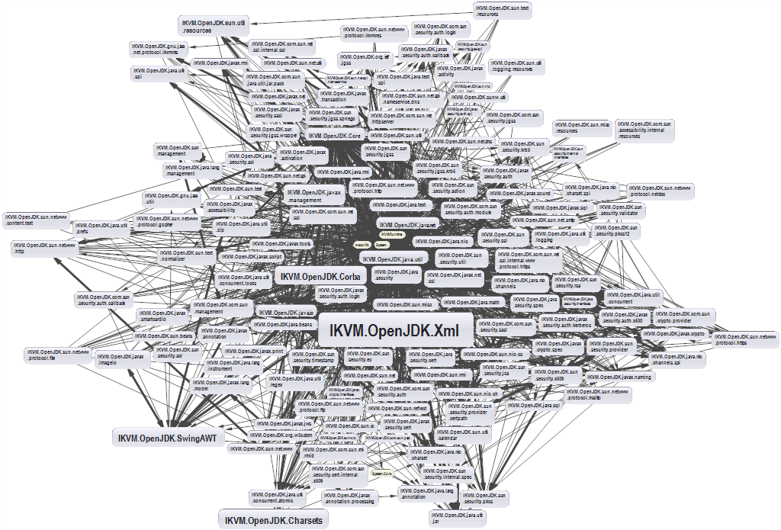
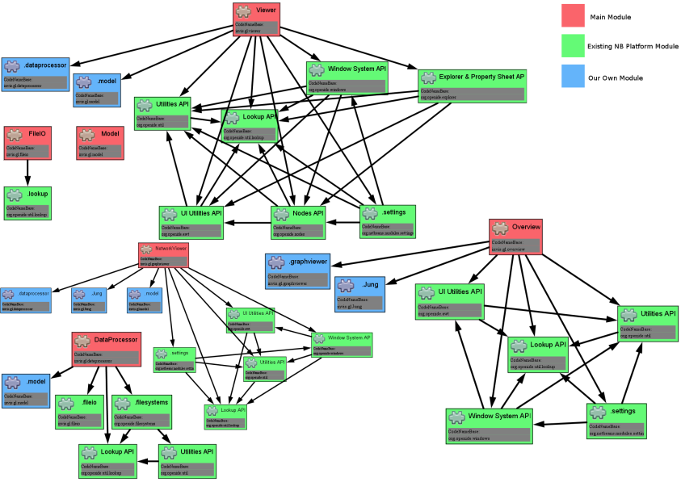
Dependencies and Coupling
Depend directly on other modules
Depend on abstractions

Slide 48
Dependency Examples
A dependency is any external component / system:
Framework
3rd party library
Database
File system
Email
Web service
System resource (e.g. clock)
Configuration
The new keyword
Static method
Global function
Random generator
Console
Notes:
A dependency is any external component / system:
Framework
Third party library
Database
File system
Email
Web service
System resource (e.g. clock)
Configuration
The new keyword
Static method
Global function
Random generator
Console

Slide 49
Dependencies in Traditional Programming
High level modules use lower level modules
UI
Business Layer
Database
Utilities
External Libraries
Infrastructure
Notes:
Traditional programming
High level modules use lower lever modules
E.g. UI depends on the Business Layer
Business layer depends on Infrastructure, database, utilities, External libraries
Static methods (Façade for example)
Classes are instantiated everywhere

Slide 50
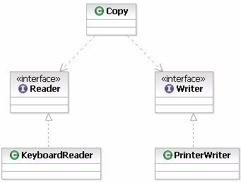
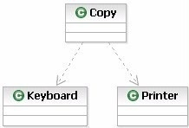
Depend on Abstractions
Notes:
Depend on Abstractions
Depend on abstractions means to work through interfaces instead directly use dependent classes

Slide 51



Types of Dependency Injection
Constructor
injection
Property injection
Parameter injection

Slide 52
Constructor Injection - Example
class Copy
{
private IReader reader;
private IWriter writer;
public Copy(IReader reader, IWriter writer)
{
this.reader = reader;
this.writer = writer;
}
// Read/Write data through the reader/writer
}
var copy = new Copy(new ConsoleReader(), new FileWriter("out.txt"));

Slide 53
Constructor Injection – Pros and Cons
Pros
Class’ requirements are self-documenting
We don’t have to worry about state validation
Cons
Too many parameters
Sometimes, the functionality doesn’t need all of the dependencies

Slide 54
Property Injection - Example
class Copy
{
public IReader Reader { get; set; }
public IWriter Writer { get; set; }
public void CopyAllChars(reader, writer)
{
// Read/Write data through the reader/writer
}
}
Copy copy = new Copy();
copy.Reader = new ConsoleReader();
copy.Writer = new FileWriter("output.txt");
copy.CopyAllChars();

Slide 55
Property Injection – Pros and Cons
Pros
Functionality can be changed at any time
That makes the code very flexible
Cons
State can be invalid
Less intuitive to use

Slide 56
Parameter Injection - Example
class Copy
{
public CopyAllChars(IReader reader, IWriter writer)
{
// Read/Write data through the Reader/Writer
}
}
Copy copy = new Copy();
var reader = new ConsoleReader();
var writer = new FileWriter("output.txt");
copy.CopyAllChars(reader, writer);

Slide 57
Parameter Injection – Pros and Cons
Pros
Changes are only localized to the method
Cons
Too many parameters
Breaks the method signature

Slide 58
DIP Violations
Classic DIP Violations:
Using the new keyword
Using static methods / properties
How to fix code, that violates the DIP:
Extract interfaces + use constructor injection
Set up an Inversion of Control (IoC) container
Notes:
Classic violations of DIP
Using of the new keyword
Using static methods / properties
How to fix broken DIP?
Extract interfaces + use constructor injection
Inversion of Control (IoC) container

Slide 59
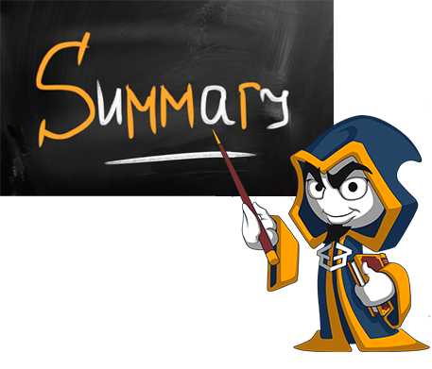
Summary
Single Responsibility Principle
Open/Closed Principle
Liskov Substitution Principle
Interface Segregation Principle
Dependency Inversion

Slide 60
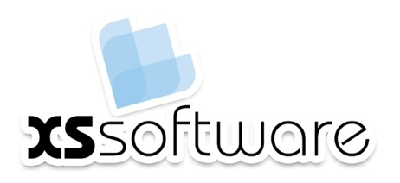






SOLID Principles
https://softuni.bg/courses/csharp-oop-advanced-high-quality-code

Slide 61
License
This course (slides, examples, demos, videos, homework, etc.) is licensed under the "Creative Commons Attribution-NonCommercial-ShareAlike 4.0 International" license
Attribution: this work may contain portions from
"Fundamentals of Computer Programming with C#" book by Svetlin Nakov & Co. under CC-BY-SA license
"C# Part I" course by Telerik Academy under CC-BY-NC-SA license
"C# Part II" course by Telerik Academy under CC-BY-NC-SA license

Slide 62





Trainings @ Software University (SoftUni)
Software University – High-Quality Education, Profession and Job for Software Developers
softuni.bg
Software University Foundation
http://softuni.foundation/
Software University @ Facebook
facebook.com/SoftwareUniversity
Software University Forums
forum.softuni.bg

